Slide 1
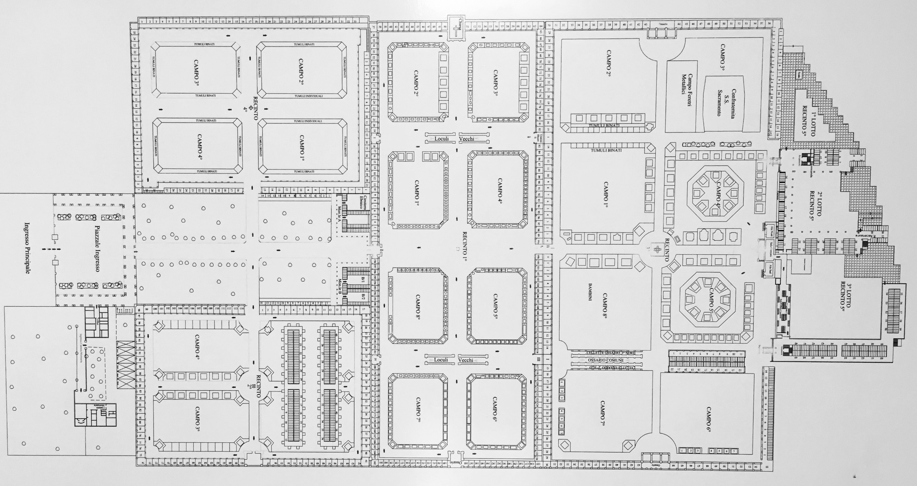
UGO FERRANDI

Slide 5
